Slide 1
CACAT-CACAT PENGECORAN
By AKHSANU TAKWIM

Slide 2
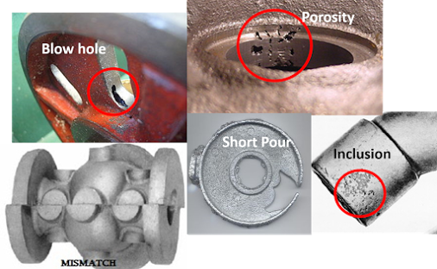
Macam-macam Cacat Pengecoran

Slide 4
Cacat Visible

Slide 5
Cacat Permukaan

Slide 6
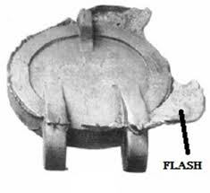
Flash

Slide 7
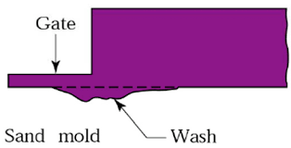
Wash

Slide 8
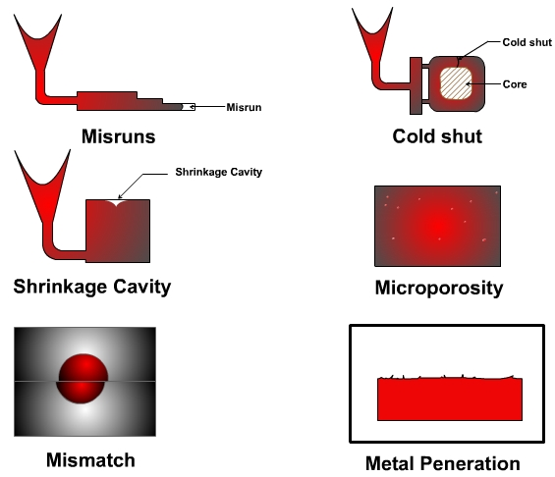

Slide 9
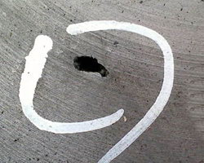
Sand Hole

Slide 10
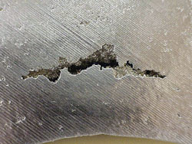
Aksial Srinkage

Slide 11
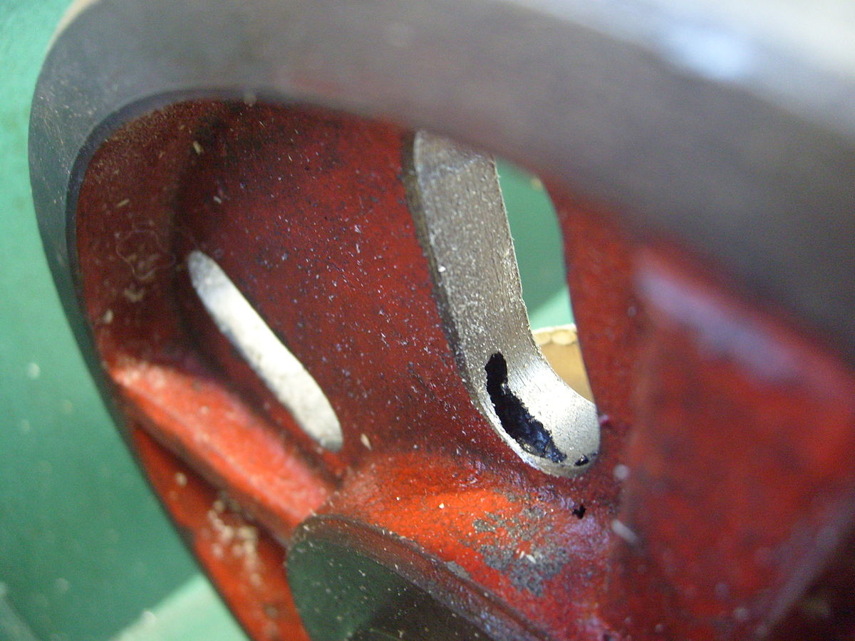
Blow hole

Slide 12
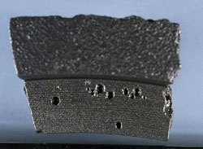
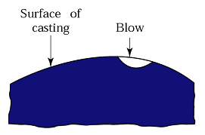
Blow Hole

Slide 13
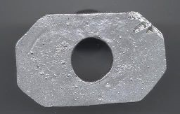
Pin Hole

Slide 14
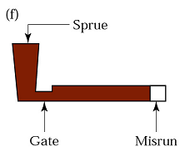
Misrun

Slide 15
CRACK

Slide 16
Cold Shut dan Cold Shot

